Slide 1


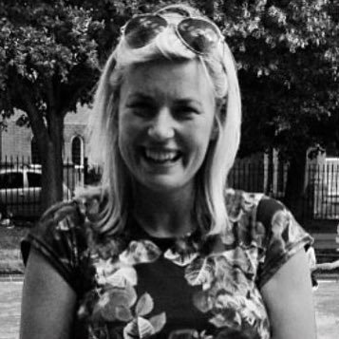
Water Stories
Information for teachers
Story writing competition 2021
Zena Chadwick
English Teacher and Head of Faculty
@zena_chadwick

Slide 2
What are stories for?
Telling a story is a way of understanding the world.
Stories help us make sense of the world.
Stories can change the world.
Here is a short video on the power of stories:
https://www.bbc.co.uk/ideas/videos/how-stories-shape-our-minds/p07h9t70

Slide 3

What else could I use as a stimulus for writing in the classroom?
A poem?
Blessing by Imtiaz Dharker

Slide 4
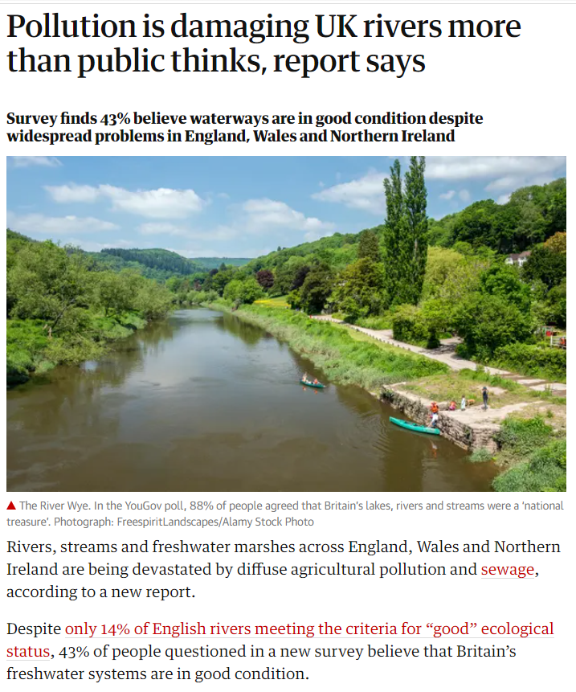
What else could I use as a stimulus for writing in the classroom?
A non-fiction article?

Slide 5
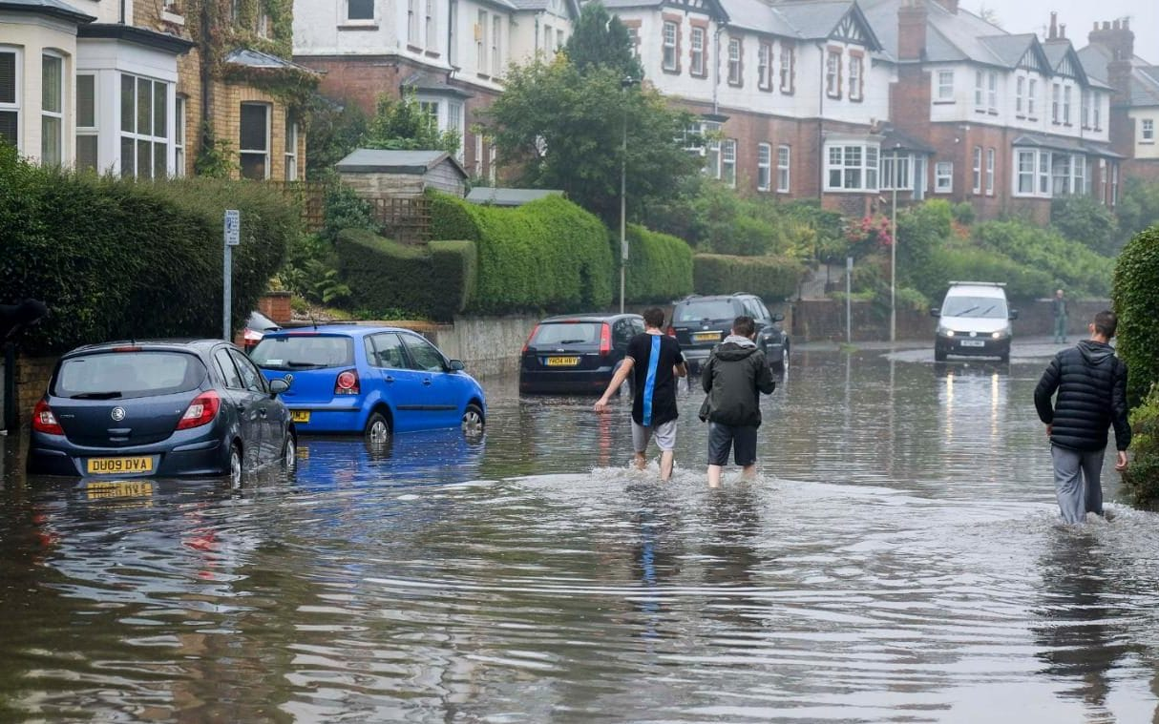
What else could I use as a stimulus for writing in the classroom?
An image?

Slide 6
Key competition information:
Deadline for submission of the story: Monday 22 November
Winners will be announced: January 2022
Story length: 500 - 750 words
The competition is open to participants aged 9 to 14 years old from across the UK
Open to individual and school submissions, but each writer can only take part once
Please submit via the online submission form, it will open on the webpage later in September
Also check the webpage for information on judging criteria

Slide 7
For more visit https://literacytrust.org.uk/water-stories
Story Writing
Competition

