Slide 1
Wellbeing and
reading
In partnership with
T: 020 7587 1842
W: literacytrust.org.uk
Twitter: @Literacy_Trust
Facebook: nationalliteracytrust
Instagram: @literacy_trust

Slide 2
What do we mean by wellbeing?
“The state of being comfortable, healthy, or happy.”
Oxford Dictionary

Slide 3
What can stop us feeling happy?
Social Media
Friendship problems
Family problems
School work
Loneliness
Grief
Feeling different
Fear

Slide 4
Everybody feels like this sometimes

Slide 5
Pressures from all around us can make us feel worse.
Social media in particular can cause added worry and strain.

Slide 6
What can we do to help ourselves?
The good news is that we CAN help ourselves.
READING for just ten minutes a day can reduce stress and make you feel happier.

Slide 7
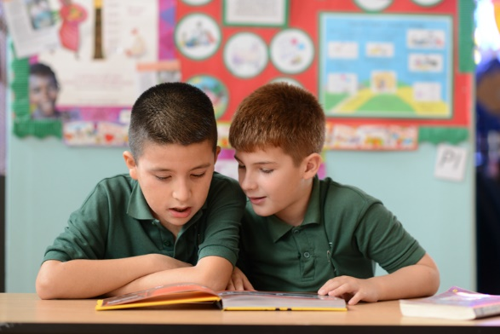
How can reading for enjoyment help?
Reading for enjoyment can:
Help you feel you are not alone
Help you face things that are hard to talk about
Help you understand things you are not sure about

Slide 8
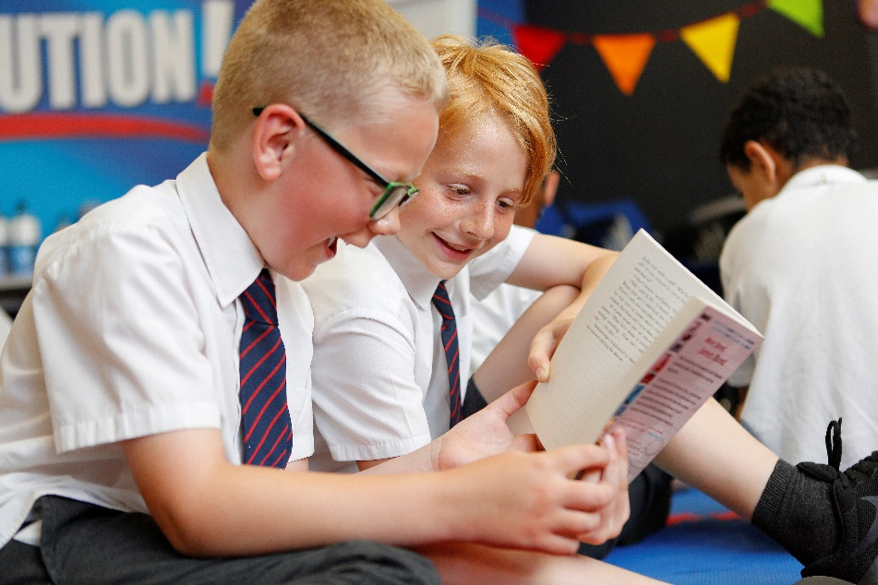
How can reading for enjoyment help?
Reading for enjoyment can:
Help you share worries with others
Help you relax and de-stress
Make you smile!

Slide 9
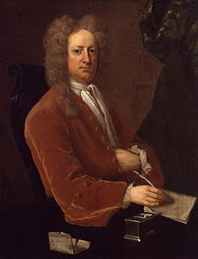
Exercise your mind!
“Reading is to the mind what exercise is to the body”
Joseph Addison (1672-1719)

Slide 10
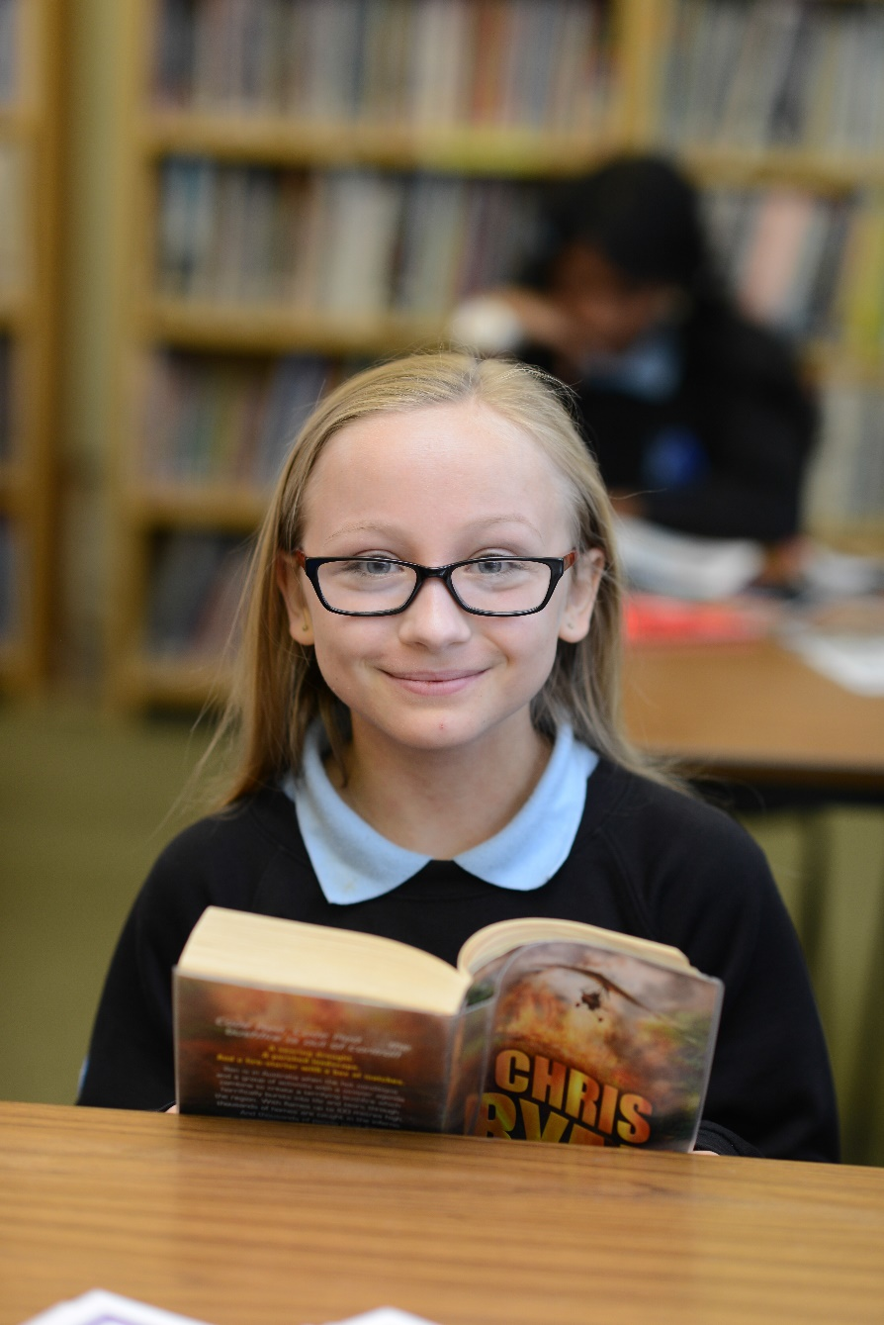
So - start reading!
If you don’t have books at home use your school or local library and borrow them.
Not sure what to read? Ask your librarian, teacher or parent to help you find the right book.
Join your school book group and try reading something new. Share your reading ideas and listen to others.
Read anywhere – you can take books with you wherever you go.

Slide 11
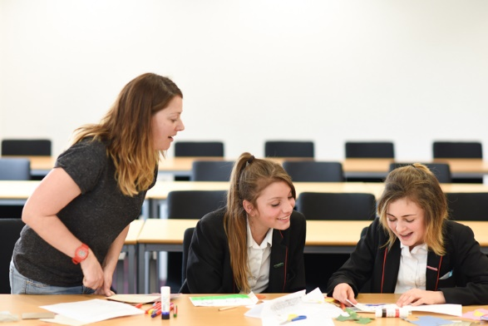
Read everything and everywhere!
Read whatever you enjoy – chapter books, graphic novels, comics, poetry and short stories.
Read aloud or listen to an audio book – if you can’t read well, ask someone to read aloud to you.
Talk about books with your friends and family and share what you’ve read.

Slide 12
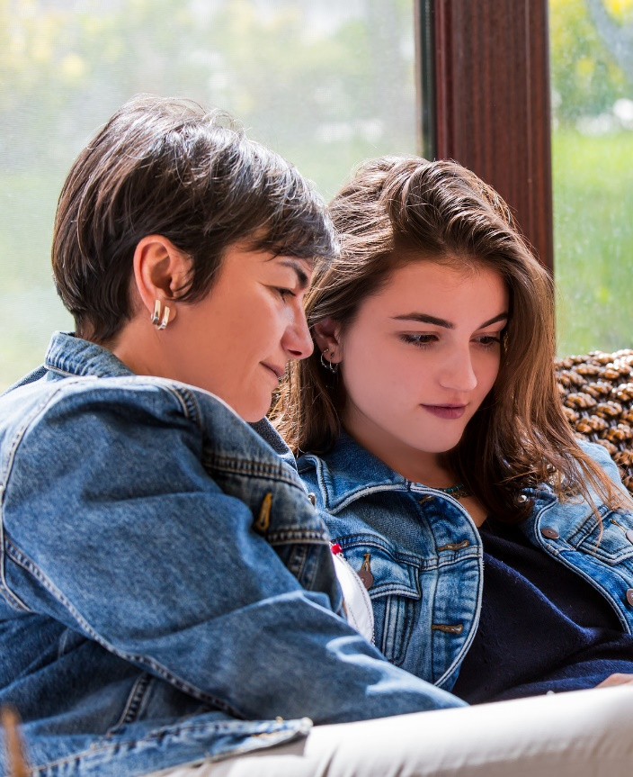
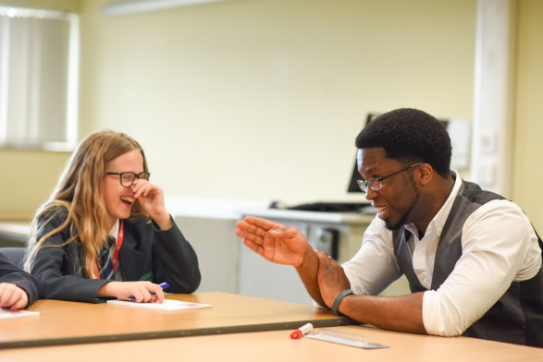
Don’t forget...
If you’re worried or anxious about anything, or if you’re concerned for a friend, talk to a grown up such as a teacher or a family member. They should be able to help.

Slide 13
In partnership with

